Slide 1

A Presentation on
ZnO
Piezoelectric Oxide
Prepared by
Abdullah Shahriar
201711037

Slide 2

Introduction
Piezoelectricity is the phenomenon where electricity is generated by applying mechanical stress to some certain materials.
piezoelectricity?
Piezoelectric oxides are such oxides
which accumulates piezoelectricity.
The term was first coined in 1880 by two French physicists, brothers Pierre Currie and Jacques Curie
The piezoelectric effect of ZnO first came to light in 2006 when two researcher from Georgia Institute of Technology published a paper regarding this issue.

Slide 3


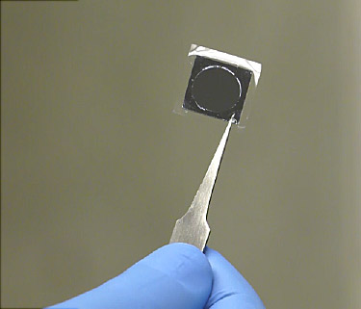
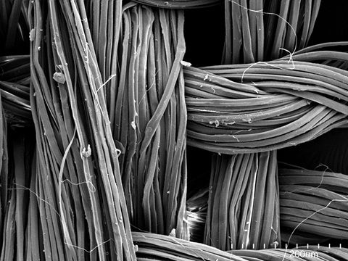
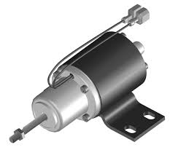
Applications
Sensors
Where is
ZnO
used?
Nanogenerators
Nanowires
Actuators

Slide 4
More Applications
Automobile Industry
Microphones
Microscopes
Inkjet Printers
Ultrasound Transducers

Slide 5

Scopes
ZnO as nanocarriers for improved drug delivery
Piezoelectric actuators using ZnO for precise movement
Engineers are aiming to convert highways into renewable energy generators

Slide 6

Researches
Flexible energy-harvesting devices
.
Photo-responsive ZnO films
High performance transistors and
semiconductors using ZnO
Piezoelectric coils for loudspeakers
Piezoelectric fibers for charging gadgets

Slide 7


